Slide 1

Title: Online Sales Data Analysis
Presented By: Sumit

Slide 2

Project Overview :
This project aims to analyze online sales data to uncover insights and trends.
SQL is used for data manipulation and analysis to ensure accurate results.
The project covers data cleaning and exploratory data analysis (EDA).

Slide 3
Objectives :
Understand
Understand sales trends across different product categories and regions.
Identify
Identify top-performing products and sales patterns.
Provide
Provide actionable insights for business decision-making.

Slide 4

Dataset Description :
The dataset consists of the following columns:
Transaction id
Date
Product category
Product name
Units sold
Unit price
Total revenue
Region
Payment method

Slide 5

Data Source :
The data was sourced from the company's sales database, capturing transactions from various regions and product categories.

Slide 6
Data Cleaning :
Removed duplicate records to ensure data integrity.
Filled missing values in unit price with the average price of respective products.
Corrected data types for Date, units sold, and total revenue.

Slide 7
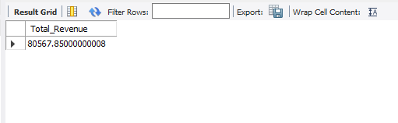
Analysis :
Calculate the total revenue for all sales?
OUTPUT :-

Slide 8

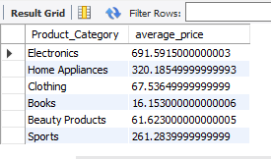
Analysis :
2. Calculate the average unit price for each product category?
OUTPUT -

Slide 9

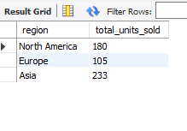
Analysis :
3. Calculate the total units sold in each region?
OUTPUT -

Slide 10

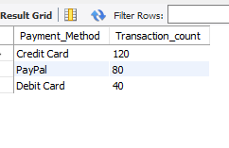
Analysis :
4. Count the number of transactions for each payment method?
OUTPUT -

Slide 11

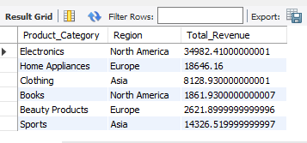
Analysis :
5. Revenue by Product Category and Region?
OUTPUT -

Slide 12

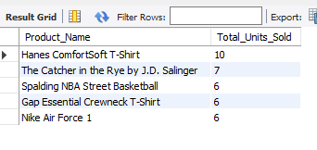
Analysis :
6. Find the top 5 products by total units sold?
OUTPUT -

Slide 13
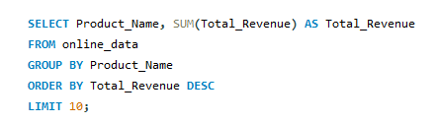
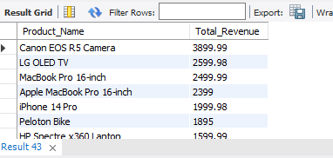
Analysis :
7. Calculate the revenue contribution of the top 10 products?
OUTPUT -

Slide 14


Analysis :
8. Calculate the total number of units sold per transaction?
OUTPUT -

Slide 15

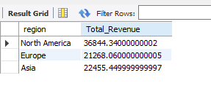
Analysis :
9. Compare total sales between different regions?
OUTPUT -

Slide 16

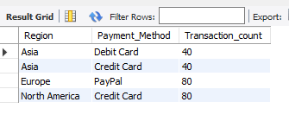
Analysis :
10. Find the most popular payment method in each region?
OUTPUT -

Slide 17

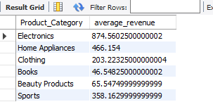
Analysis :
11. Calculate the average revenue per transaction for each product category?
OUTPUT -

Slide 18
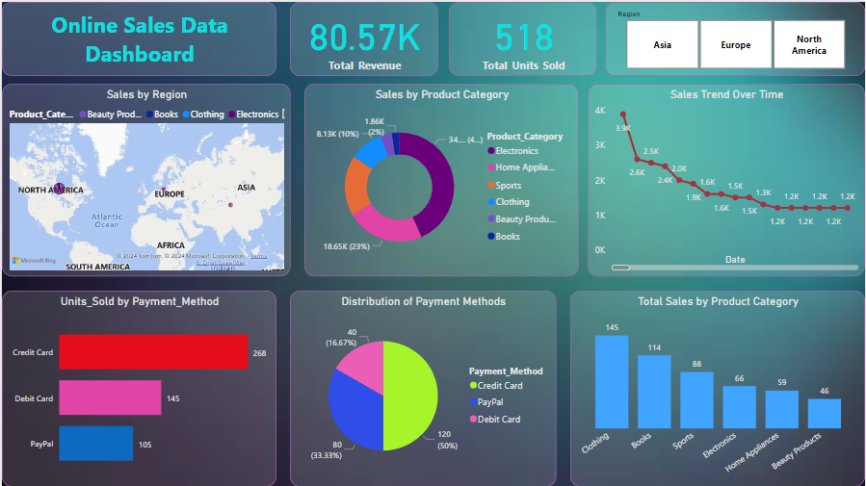

Slide 19
Key Insights :
Credit cards are the most popular payment method, followed by debit cards and PayPal. This is evident from the Distribution of Payment Methods section of the dashboard, which shows that credit cards account for 40% of total sales, debit cards account for 33.33% of total sales, and PayPal accounts for 26.67% of total sales.
The top-selling product category is electronics, followed by beauty products and clothing. The Sales by Product Category section shows that electronics have the highest total revenue at 8.13K, followed by beauty products at 3.4K and clothing at 2.5K.

Slide 20
Key Insights :
North America is the top-selling region, followed by Asia and Europe. The Sales by Region section shows that North America has the highest total revenue at 18.65K, followed by Asia at 8.13K and Europe at 518.
Book sales are very low across all regions. This is evident from the Sales by Product Category section, which shows that the total revenue from book sales is very low across all regions. For instance, in North America, book sales account for only OK.

Slide 21
Key Insights :
Sales are trending upwards over time. This is evident from the Sales Trend Over Time section of the dashboard.
The Atlantic region within North America has the highest sales for Beauty Products. While North America is the top-selling region overall, the Atlantic region within North America accounts for the highest sales in Beauty Products at 1.2K.

Slide 22

THANK YOU!

